Slide 1
Deep Portfolio
Kyounghun Bae
-Hanyang University-

Slide 2
Contents
traditional portfolio selection
deep portfolio four steps
autoencode, calibrate, validate, verify
deep portfolio characteristics
new paradigm based on deep portfolio

Slide 3
Traditional Portfolio Selection
Markowitz optimization
mean, variance and covariance
ignore higher moments, higher co-moments
ignore jump and large volatility
multifactor model + alpha research
back-testing issue
static
AQR example

Slide 4
Deep Portfolios
4- Steps: auto-encode, calibrate, validate, and verify
in-sample fitting: find deep portfolio
auto-encoding: find the market-map
extract risk factors
auto-encoder
calibrating: find the portfolio-map
create a portfolio from X for the approximation of objective Y
Kolmogorov-Arnold theorem

Slide 5
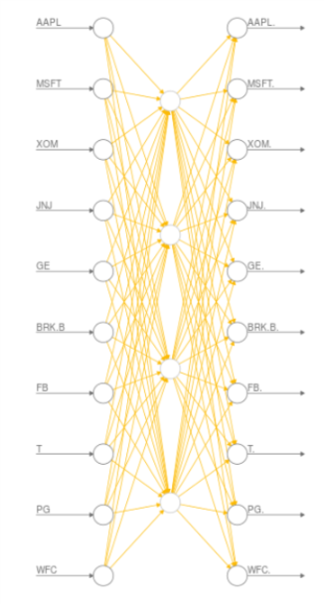
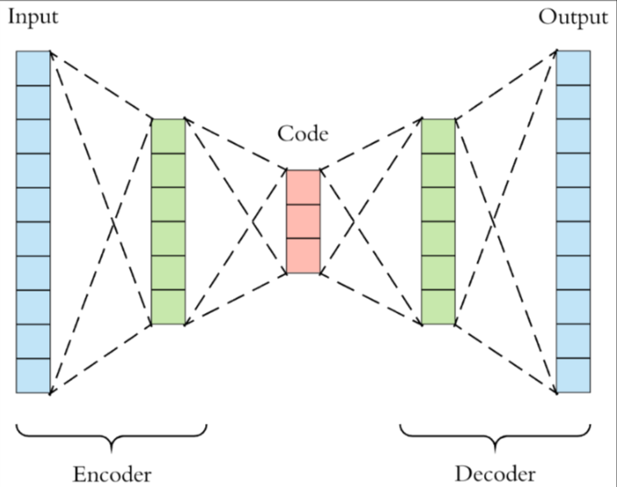
Autoencoder: extract risk factors

Slide 6
Deep Portfolios
out-of-sample test: test deep portfolio
validating: Find Lm and Lp to balance the trade-off between the two errors: e_m, and e_p
verifying
The verification step uses a cross validation approach to trace out an ex post deep portfolio efficient frontier.
note: activation functions: tanh or rectified linear units (ReLU)

Slide 7
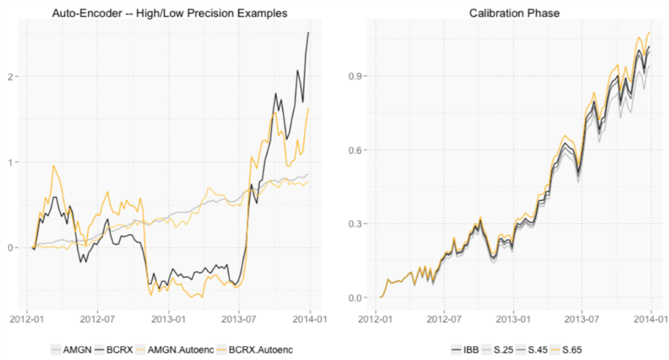
Heaton, Polson and Witte (2016): Figure 2

Slide 8
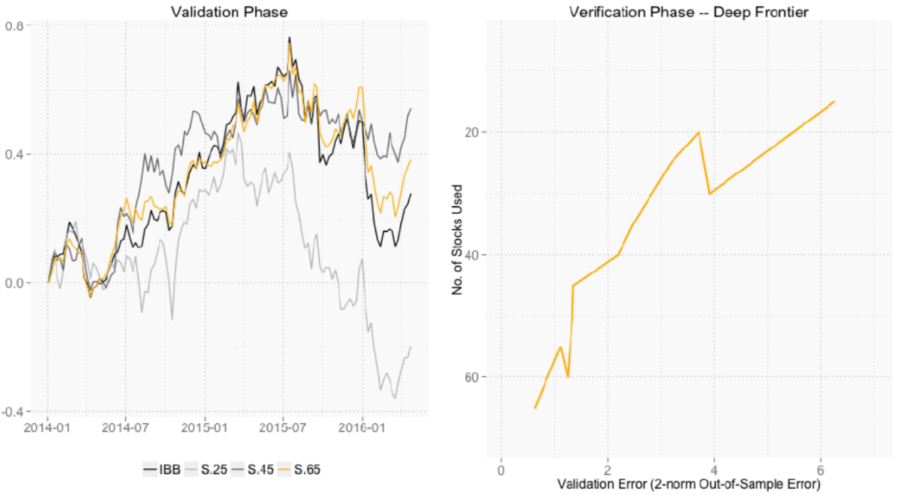
Heaton, Polson and Witte (2016): Figure 2

Slide 9
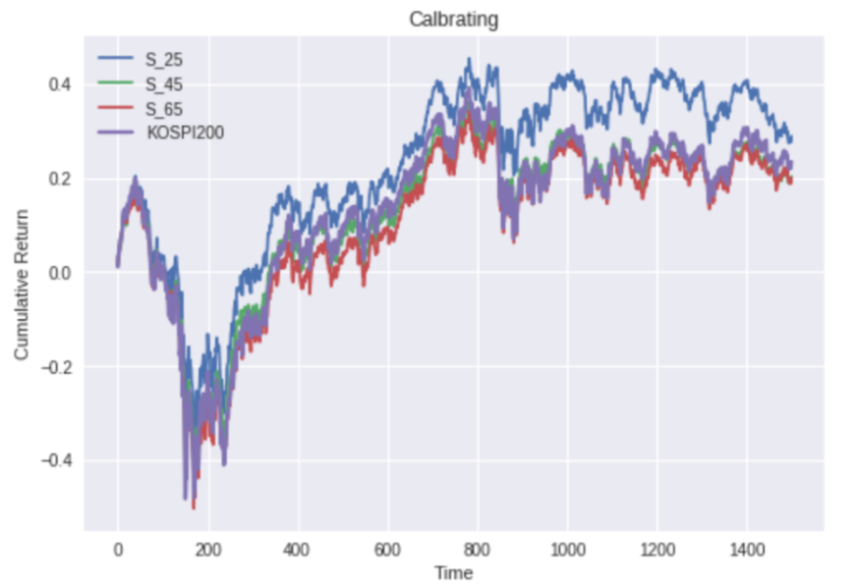
Bae and Kang (2018): Calibration (In-Sample)

Slide 10
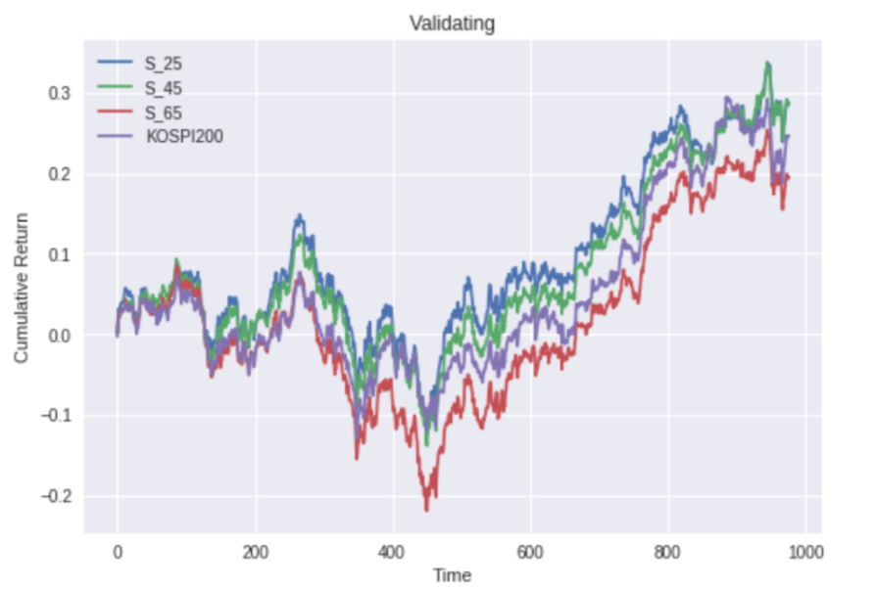
Bae and Kang (2018): Validation (Out-Sample)

Slide 11
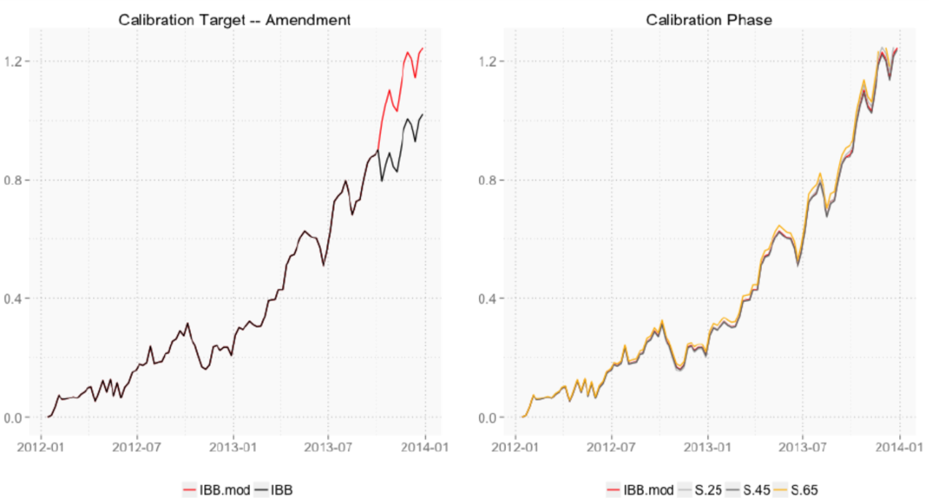
Heaton, Polson and Witte (2016): Figure 3

Slide 12
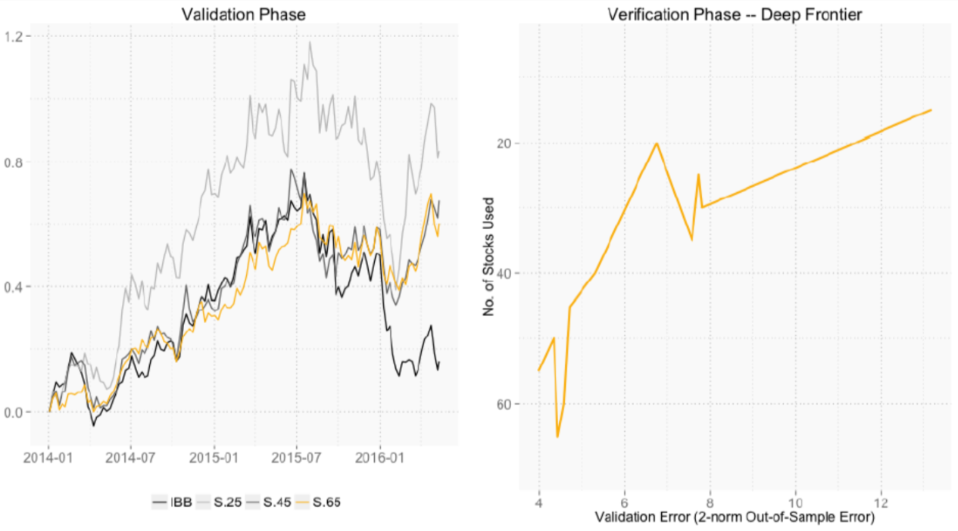
Heaton, Polson and Witte (2016): Figure 3

Slide 13
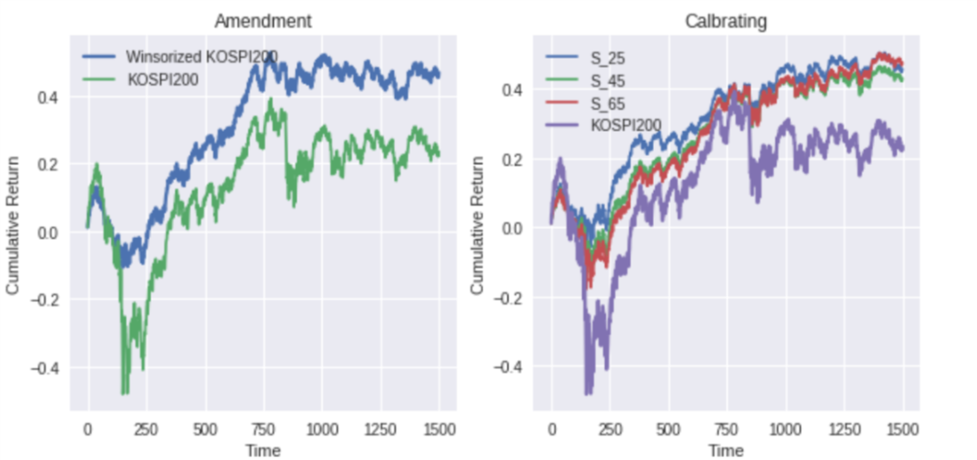
Bae and Kang (2018): Calibration (In-Sample)

Slide 14
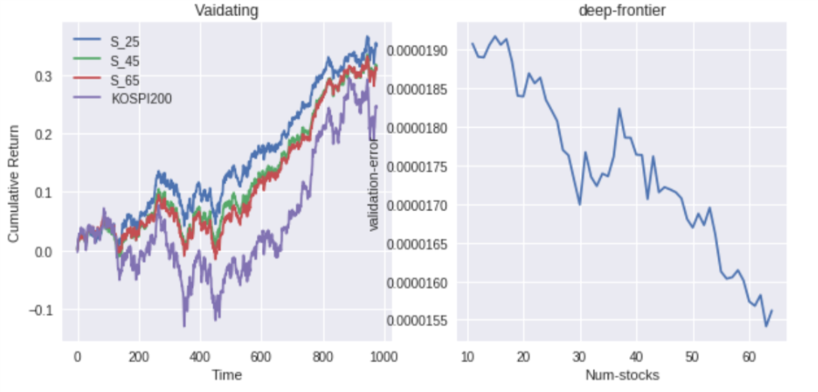
Bae and Kang (2018): Validation and Verification (Out-Sample)

Slide 15
Deep Portfolio Characteristics
reduce model dependence
no model for variance-covariance matrices
allow for non-linearities in a time-varying implied variance-covariance structure
portfolio optimization and inefficiency detection become an almost entirely data driven (and therefore model free) tasks.

Slide 16
Deep Portfolio Characteristics
avoid the specification of any statistical inputs such as expected returns or variance-covariance matrices.
if we had allowed for richer non-linear structure in determining the market-cap, we could capture lower pricing errors whilst still providing good-out-of-sample portfolio efficiency. (need to include non-linear payoff from derivatives contracts)
conditioning variable z: accounting variable or derivative price

Slide 17
New Paradigm based on Deep Portfolio
feed alpha portfolios and risk managements tools to deep portfolios
track benchmark (e.g. KOSPI 200, S&P 500)
add alpha (1%, 2%, 3%, or etc)
let deep portfolios to detect the best active-alpha
avoid large drawdowns
let deep portfolios to use the best risk managements tools

Slide 18
New Paradigm based on Deep Portfolio
conditioning variables: financial data + textual data
options and futures open interests
all news articles
facebook
twitter
Blogs: seeking alpha, etc
analysts reports

Slide 19
New Paradigm based on Deep Portfolio
tracking benchmark
dynamic alpha generating
dynamic risk managements

